Slide 1

. TITLE: DATA WRANGLING PROJECT
. SUBTITLE: MERGING, CLEANING, AND ANALYZING REAL-WORLD DATA
. PRESENTED BY: SIDDIQUI SABA
. COMPANY: NEXTHIKES IT SOLUTIONS

Slide 2


INTRODUCTION
. PERFORMED DATA WRANGLING ON 3 DATASETS.
. MERGED DATASETS, HANDLED MISSING VALUES, REMOVED OUTLIERS.
. APPLIED VARIOUS STATISTICAL TECHNIQUES AND VISUALIZATIONS.

Slide 3
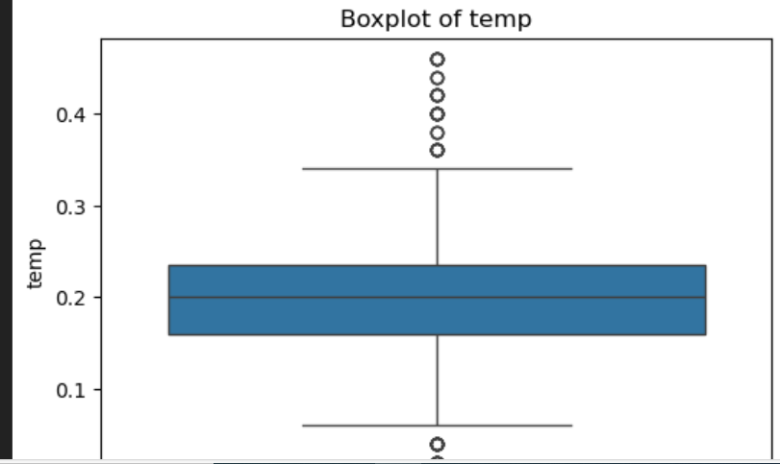
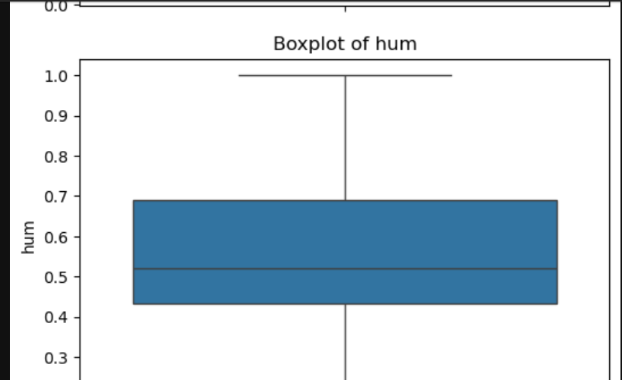

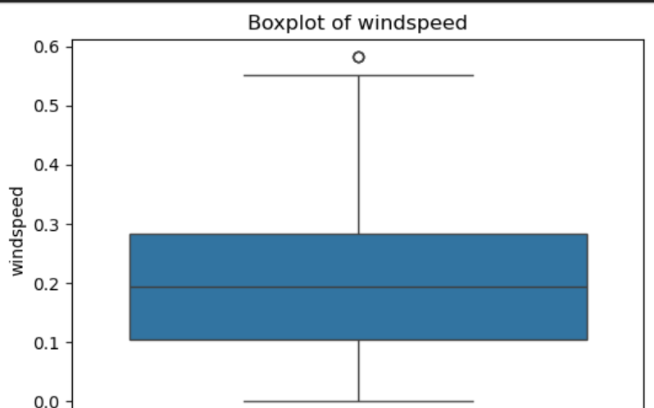
SCREENSHOT 1

Slide 4
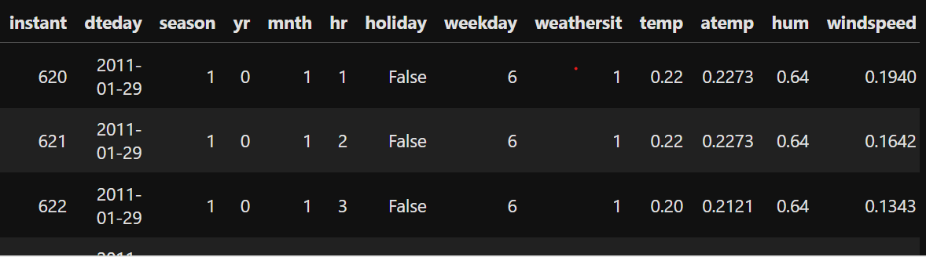
SCREENSHOT 2

Slide 5
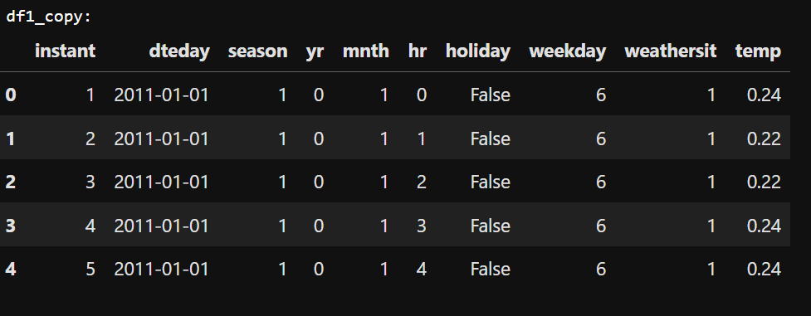
SCREENSHOT 3

Slide 6
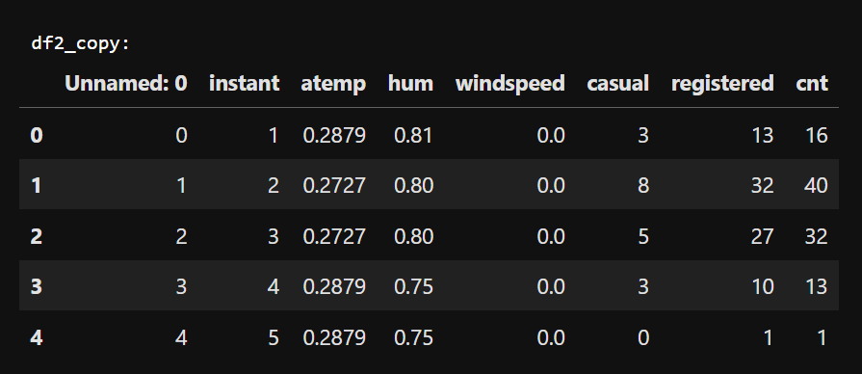
SCREENSHOT 4

Slide 7
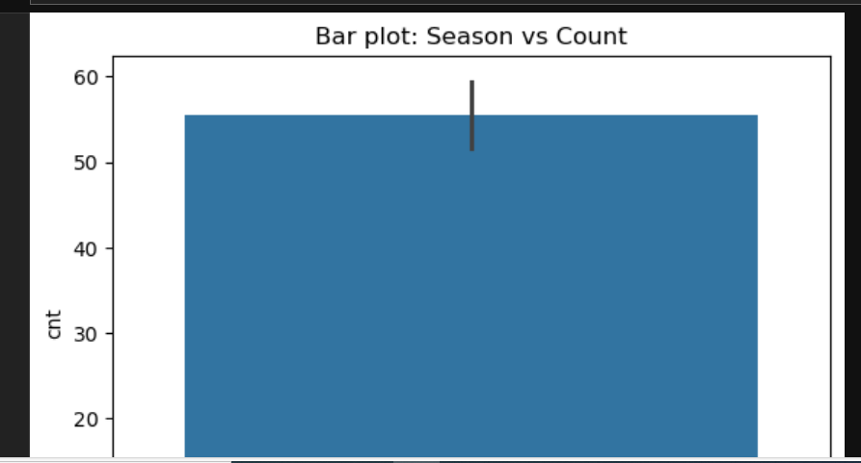
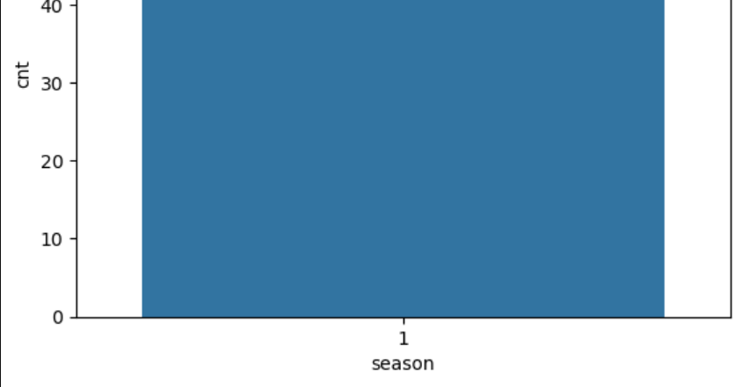
SCREENSHOT 5

Slide 8
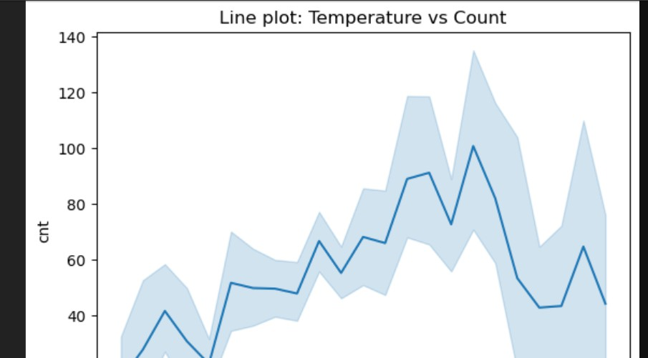
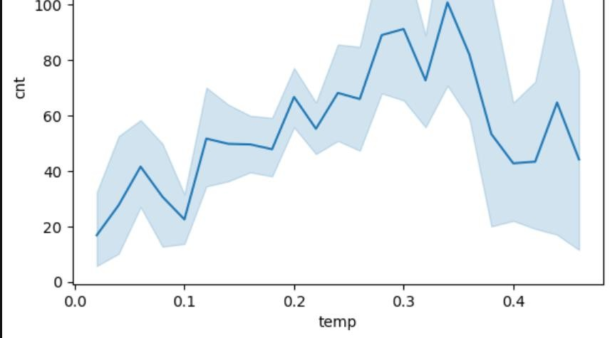
SCREENSHOT 6

Slide 9
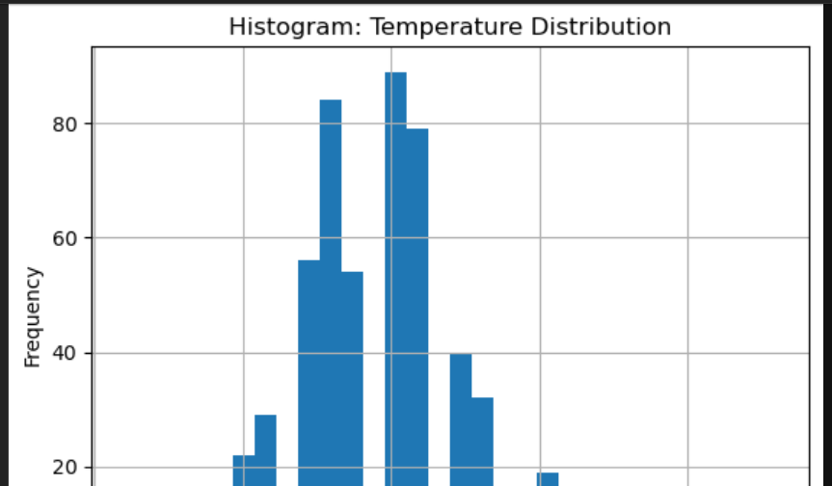
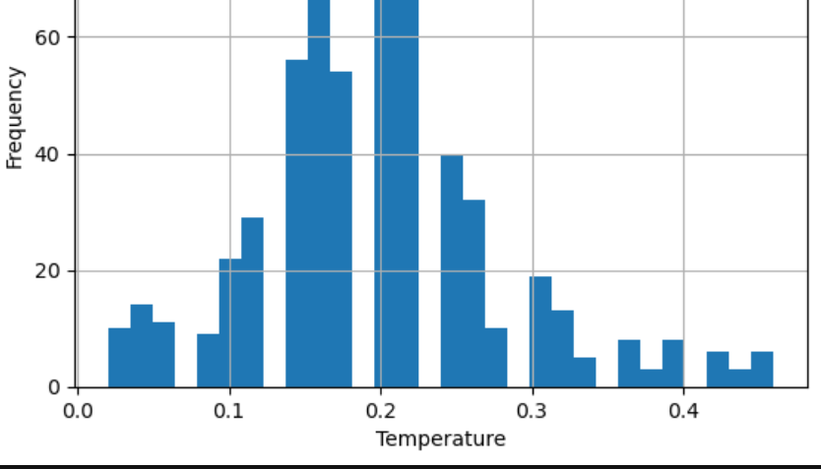
SCREENSHOT 7

Slide 10

DATASET MERGING
. STEP 1: MERGED DATASET 1 AND DATASET 2 USING COMMON COLUMNS.
. STEP 2: MERGED RESULT WITH DATASET 3 ON COLUMN "INSTANT".
. SCREENSHOT: SHOW FINAL_MERGED.HEAD() OUTPUT

Slide 11

VISUALIZING MERGED DATASET
. VISUALIZED COLUMNS FROM DATASET 1 AND DATASET 2.
. ADDED MERGED DATASET SCREENSHOTS.
. INCLUDED HEATMAPS AND HISTOGRAMS.
. SCREENSHOTS: VISUALS OF DATASET 1, 2, AND FINAL MERGED DATA.

Slide 12

OUTLIERS WERE DETECTED USING BOXPLOTS.
. NUMERIC COLUMNS LIKE 'TEMP', 'HUM', AND 'WINDSPEED' EXAMINED.
. SCREENSHOT: BOXPLOT VISUALS

Slide 13

HANDLING OUTLIERS
. OUTLIERS HANDLED USING IQR METHOD.
. OUTLIER VALUES WERE REMOVED (NOT REPLACED)
.

Slide 14


SKEWNESS AND KURTOSIS
CALCULATED SKEWNESS TO CHECK DATA SYMMETRY. KURTOSIS USED TO ANALYZE DATA PEAKNESS. SCREENSHOT: OUTPUT OF SKEWNESS AND KURTOSIS.
CORRELATION
USED HEATMAP TO VISUALIZE CORRELATION BETWEEN NUMERIC FEATURES.
SCREENSHOT: CORRELATION HEATMAP.
VISUALIZATIONS
BAR PLOT: HOURLY DISTRIBUTION OF BIKE RENTALS.
LINE CHART: TEMPERATURE TREND ACROSS TIME. HISTOGRAM: DISTRIBUTION OF HUMIDITY. SCREENSHOTS: ALL 3 PLOTS.

Slide 15
Conclusion & Acknowledgments
. USED PANDAS AND NUMPY TO CLEAN AND ANALYZE DATA.
. DATA WRANGLING ENABLED EFFECTIVE VISUAL INSIGHTS.
. THANK YOU TO MY MENTOR FOR THEIR GUIDANCE.
. PRESENTED BY: SIDDIQUI SABA

